Slide 1
PHP PROGRAMMING
HANDLING
MULTI DIMENSIONAL ARRAYS
BY
B.AKILANDESWARI, M.C.A., M.PHIL., B.ED., PDIT,
ASSISTANT PROFESSOR,
DEPARTMENT OF COMPUTER SCIENCE,
SIGC, TRICHY-2

Slide 2
ACCESSING MULTI DIMENSIONAL ARRAY ELEMENTS
There are mainly two ways to access multidimensional array elements in PHP.
Elements can be accessed using dimensions as
array_name[‘first dimension’][‘second dimension’].
Elements can be accessed using for loop. Elements can be accessed using for each loop.

Slide 3
MULIT DIMENSIONAL ARRAY
<?php
$marks = array( "Ankit" => array("C" => 95, “C++" => 85, “PYTHON" => 74), "Ram" => array("C" => 78, “C++" => 98, “PYTHON" => 46),
"Anoop" => array("C" => 88,“C++" => 46, “PYTHON" => 99) );
// Accessing the array element using dimensions It will display the marks of
// Ankit in C subject
echo $marks['Ankit']['C'] . "\n";
// Accessing array elements using for each loop
foreach($marks as $mark) {
echo $mark['C']. " ".$mark[‘C++']." ".$mark[‘PYTHON']."\n";
}?>
95
95 85 74
78 98 46
88 46 99

Slide 4
PHP PROGRAMMING
HANDLING
MULTI DIMENSIONAL ARRAYS IN LOOPS
BY
B.AKILANDESWARI
ASST PROF, SIGC, TRICHY

Slide 5
<?php
//we create this array
$people= array(
array("name" => "Jennifer Kimbers", "email" => "abc@gmail.com",
"city" => "Seattle", "state" => "Washington"),
array("name" => "Rodney Hutchers", "email" => "def@gmail.com",
"city" => "Los Angeles", "state" => "California"),
array("name" => "Robert Smith","email" => "ghi@gmail.com",
"city" => "Michigan","state" => "Missouri") );
MULIT DIMENSIONAL ARRAY
# 1
name: Jennifer Kimbers
email: abc@gmail.com
city: Seattle
state: Washington
# 2
name: Rodney Hutchers
email: def@gmail.com
city: Los Angeles
state: California
# 3
name: Robert Smith
email: ghi@gmail.com
city: Michigan
state: Missouri
$num=0;
foreach ($people as $person)
{
$num++;
echo "<br><b># $num</b><br>";
foreach ($person as $key=>$value)
{
echo "$key: $value <br>";
}
} ?>

Slide 6
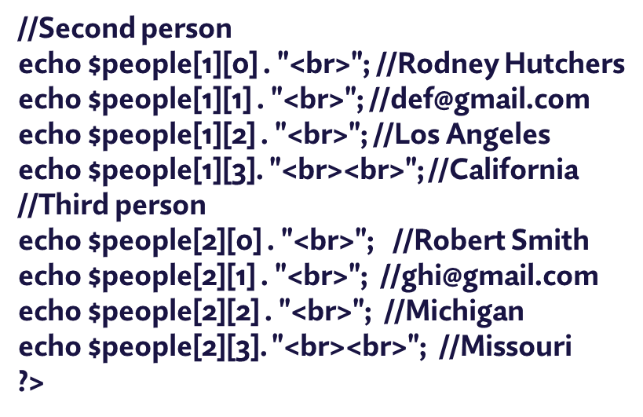
Accessing the Elements of a Multidimensional Array Without Key-Value Pairs
<?php
//we create this array
$people= array(
array("Jennifer Kimbers", "abc@gmail.com","Seattle", "Washington"),
array("Rodney Hutchers", "def@gmail.com","Los Angeles", "California"),
array("Robert Smith","ghi@gmail.com","Michigan", "Missouri") );
//Accessing the Elements of the Array
//First person
echo $people[0][0] . "<br>"; //Jennifer Kimbers
echo $people[0][1] . "<br>"; //abc@gmail.com
echo $people[0][2] . "<br>"; //Seattle
echo $people[0][3]. "<br><br>"; //Washington

Slide 7
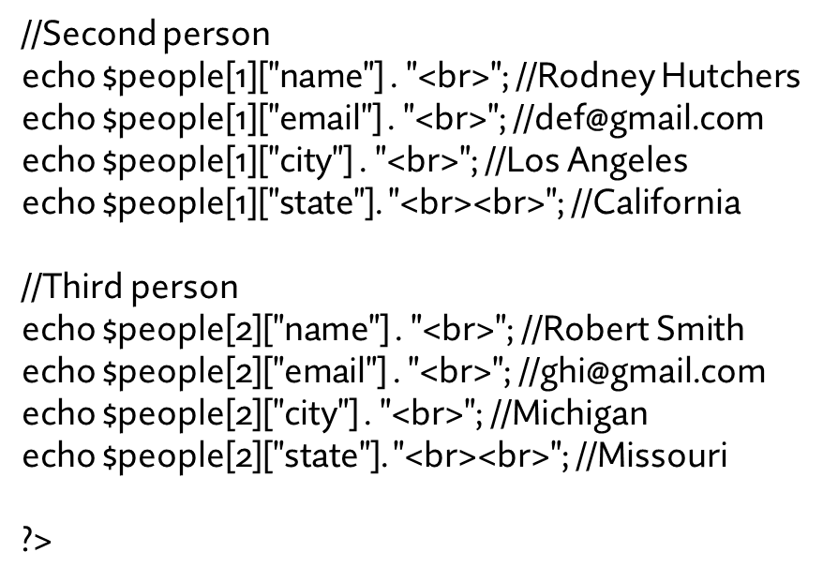
<?php
//we create this array
$people= array(
array("name" => "Jennifer Kimbers", "email" => "abc@gmail.com",
"city" => "Seattle", "state" => "Washington"),
array("name" => "Rodney Hutchers", email" => "def@gmail.com",
"city" => "Los Angeles", "state" => "California"),
array("name" => "Robert Smith",email" => "ghi@gmail.com",
"city" => "Michigan", "state" => "Missouri") );
//Accessing the Elements of the Array
//First person
echo $people[0]["name"] . "<br>"; //Jennifer Kimbers
echo $people[0]["email"] . "<br>"; //abc@gmail.com
echo $people[0]["city"] . "<br>"; //Seattle
echo $people[0]["state"]. "<br><br>"; //Washington
MULIT DIMENSIONAL ARRAY

Slide 8
ARRAY SPLITING
<?php
$fruits["good"] = "tangerine";
$fruits["better"] = "pineapple";
$fruits["best"] = "pomegranate";
$subarray = array_slice($fruits, 1, 2);
foreach ($subarray as $value) {
echo "Fruit: $value\n";
}
?>
Fruit: pineapple
Fruit: pomegranate
<?php
$fruits = array("pineapple", "pomegranate", "tangerine");
$vegetables = array("corn", "broccoli", "zucchini");
$produce = array_merge($fruits, $vegetables);
foreach ($produce as $value) {
echo "Produce item: $value\n"; } ?>
Produce item: pineapple
Produce item: pomegranate
Produce item: tangerine
Produce item: corn
Produce item: broccoli
Produce item: zucchini

Slide 9
MULIT DIMENSIONAL ARRAY
The array_flip() function flips/exchanges all keys with their associated values in an array.
<?php
$a1=array("a"=>"red","b"=>"green","c"=>"blue","d"=>"yellow");
$result=array_flip($a1);
print_r($result);
?>
OUTPUT
Array ( [red] => a [green] => b [blue] => c [yellow] => d )

Slide 10
MULIT DIMENSIONAL ARRAY
The array_diff() function compares the values of two (or more) arrays, and returns the differences.
This function compares the values of two (or more) arrays, and return an array that contains the entries from array1 that are not present in array2 or array3, etc.

Slide 11
MULIT DIMENSIONAL ARRAYS
<!DOCTYPE html>
<html>
<body>
<?php
$a1=array("a"=>"red","b"=>"green","c"=>"blue","d"=>"yellow");
$a2=array("e"=>"red","f"=>"green","g"=>"blue");
$result=array_diff($a1,$a2);
print_r($result);
?>
</body>
</html>
Array ( [d] => yellow )

Slide 12
MULIT DIMENSIONAL ARRAY
THANK YOU

